Slide 1


Paper Presentation
CSE 712
Symbolic Machine Learning - II
Group 3
Members:
Auninda Alam-21166050
Marjan Tahreen-21166049
Shohag Rana-21366015

Slide 2
INTRODUCTION
Detecting Attackable Sentences in Arguments
Yohan Jo, Seojin Bang, Emaad Manzoor, Eduard Hovy, Chris Reed

Slide 3
CONTRIBUTIONS
Introduced the problem of detecting attackable sentences in arguments
Analyzed driving reasons for attacks in arguments and the effects of sentence characteristics
The performance of machine learning models for detecting attackable sentences

Slide 4
LITERATURE REVIEW
Aristotle (2007) suggested three aspects of argument persuasiveness.
Wachsmuth et al. (2017b) summarized various aspects of argument quality studied in argumentation theory and NLP
Some research took empirical approaches and collected argument evaluation criteria from human evaluators (Habernal and Gurevych, 2016a; Wachsmuth et al., 2017a)
Some studies aimed to model the salience of individual sentences in attacked arguments (Jo et al., 2018; Ji et al., 2018)

Slide 5
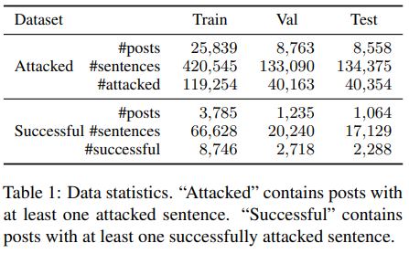
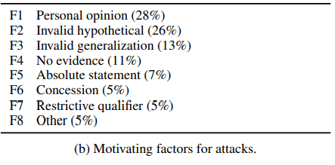
Dataset
Source
The Dataset was formed using the online discussions from the "Change My View (CMV)" subreddit.
Labelling
Each sentence in a post was labelled into three categories, i.e. successfully attacked, un-successfully attacked and unattacked.
Feature Extraction
content
external knowledge
proposition types
tone
Notes:
For predicting attacked sentences, the BERT
model’s top 1 decisions match the gold standard 50% of the time; its decisions match 78% of the time when three sentences are chosen. The BERT model’s top 1 decisions match the gold standard 28% of the time—a 27% and 10% boost from random and length-based performance, respectively.

Slide 6
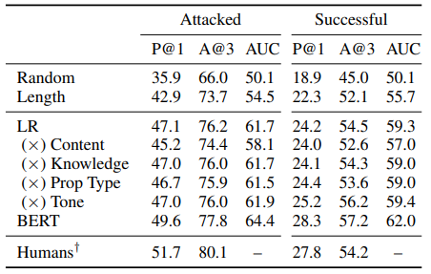
Model
Problem Formulation
P@1
A@3
AUC
ML Models
Logistic Regression
BERT
Baseline Models
Random
Length

Slide 7
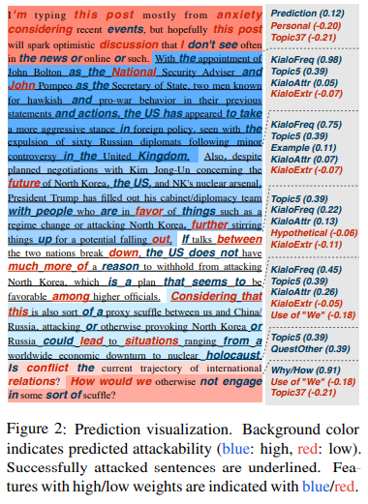
Results
Based on the Computational Model run 10 times
LR and BERT Outperform
Both the LR and BERT models significantly outperform the baselines, while the BERT model performs best.
Notes:
For predicting attacked sentences, the BERT
model’s top 1 decisions match the gold standard 50% of the time; its decisions match 78% of the time when three sentences are chosen. The BERT model’s top 1 decisions match the gold standard 28% of the time—a 27% and 10% boost from random and length-based performance, respectively.
Figure 2 illustrates how LR allows us to interpret the contribution of different features to attackability, by visualizing a post with important features highlighted. For instance, external knowledge plays a crucial role in this post; all successfully attacked sentences match substantially more Kialo statements than other sentences. The attackability scores of these sentences are also increased by the use of hypotheticals and certain n-grams like could. These features align well with the actual attacks by
successful challengers.

Slide 8



Conclusion
Notes:
This was a study on how to detect attackable sentences in
arguments for successful persuasion. Using online arguments, it is demonstrated that a sentence’s attack ability is associated with many of its characteristics regarding its content, proposition types,
and tone. Based on these findings, machine learning models can automatically detect attackable sentences, comparably well to laypeople.
This paper paves the way towards answering the causal question: would attacking a certain type of sentence in an
argument increase the probability of persuading
the opinion holder? This paper suggests initial hypotheses about the characteristics of sentences that can be successfully attacked.

